Slide 1
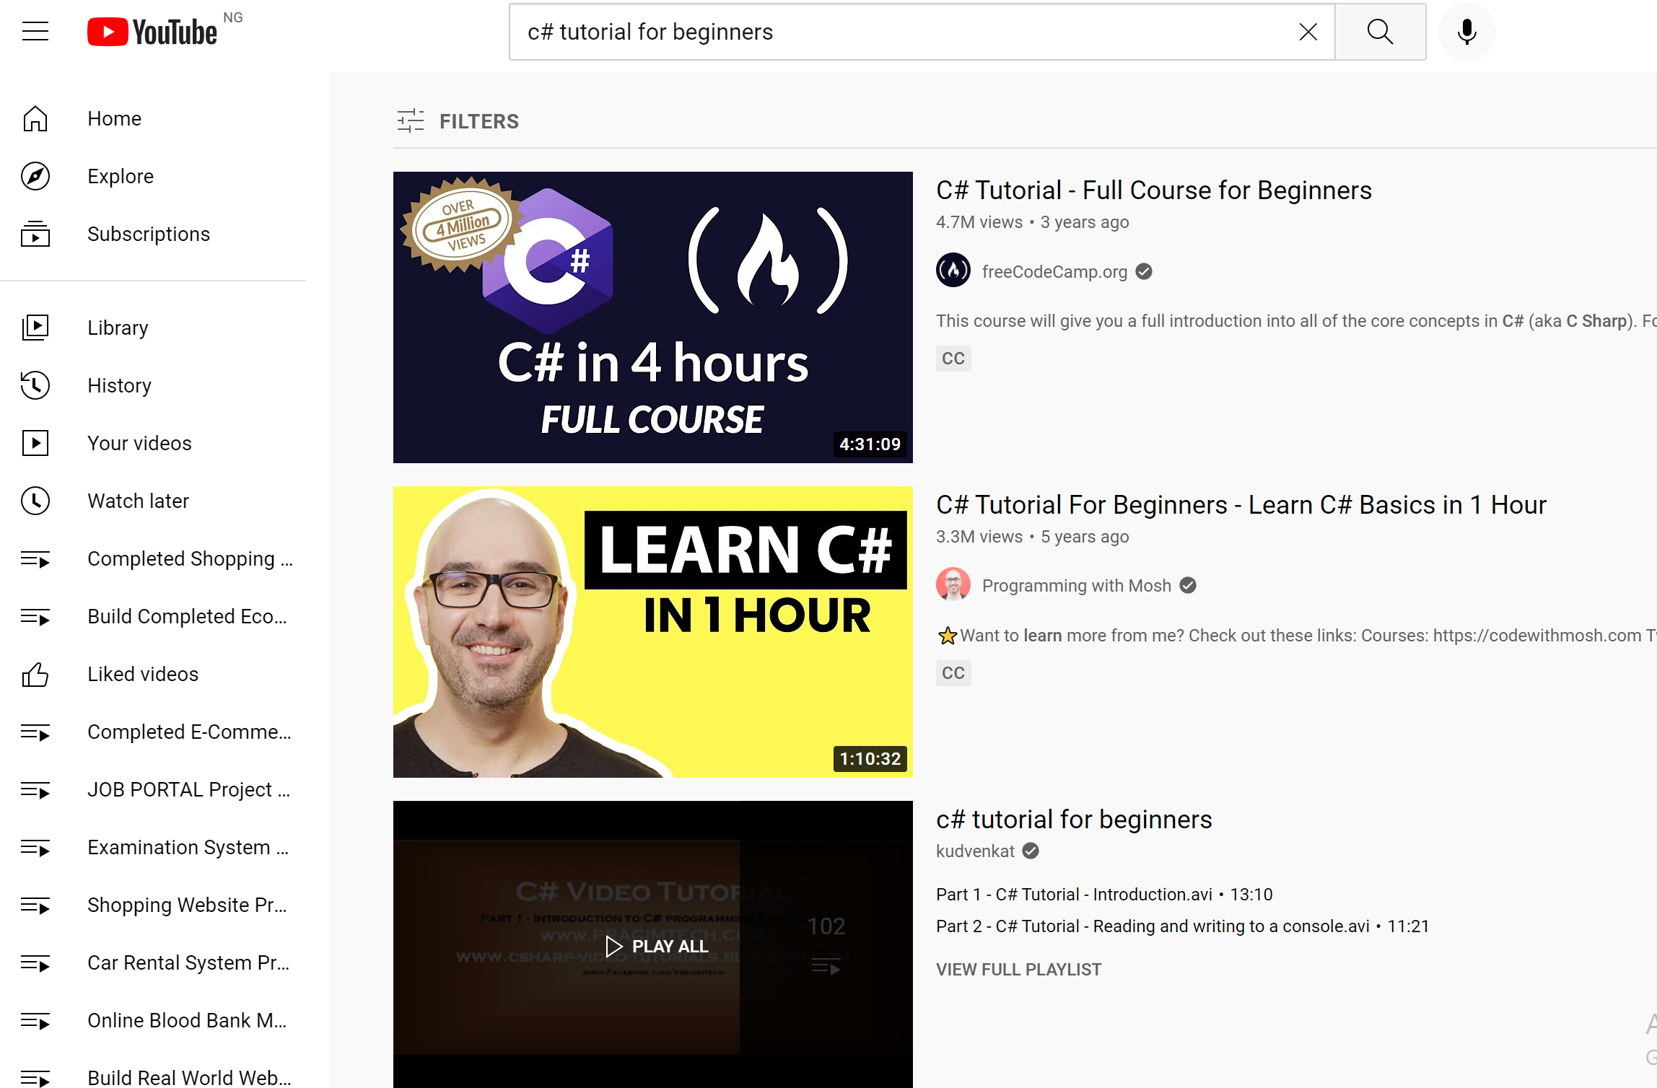
Search for the video
Select the video u want to watch

Slide 2
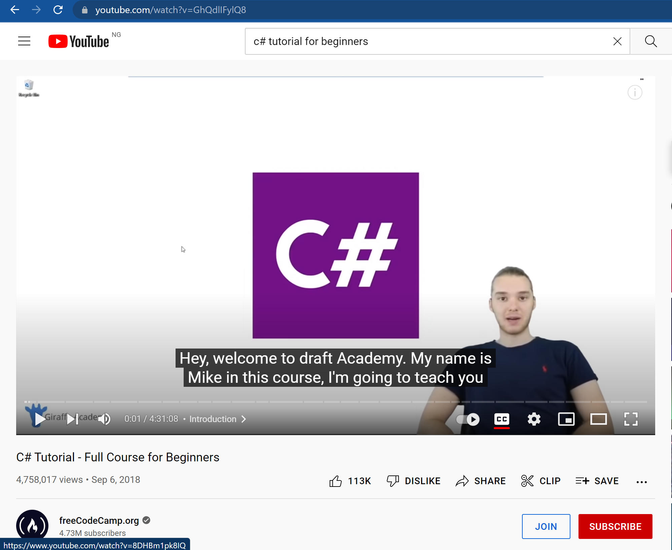
Click on share button

Slide 3
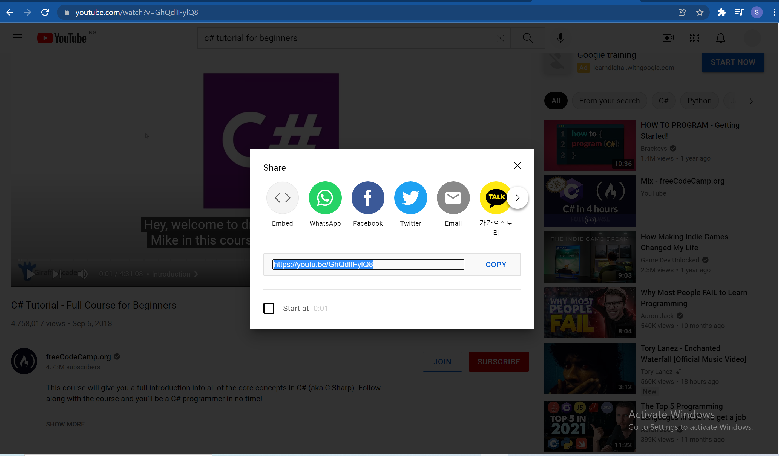
Copy link this link
U will later paste it in another web page so first copy it madam dami

Slide 4
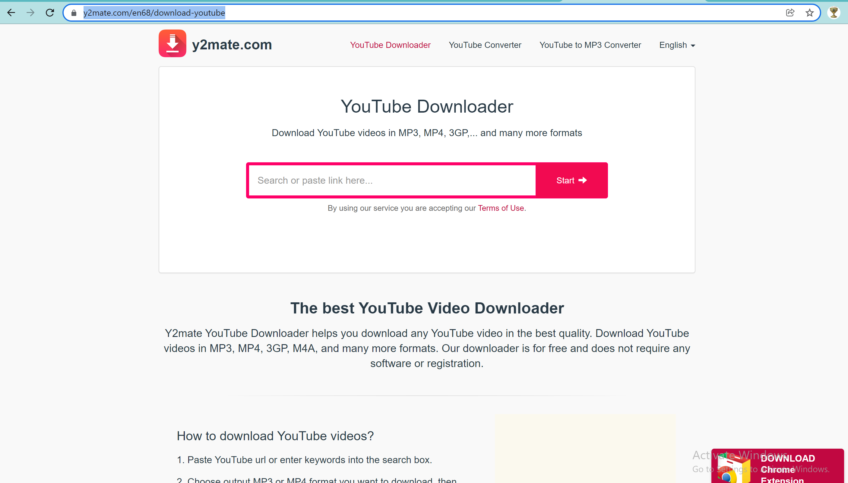
Go to this website
https://youtu.be/GhQdlIFylQ8
Paste d link here
Then click on start

Slide 5
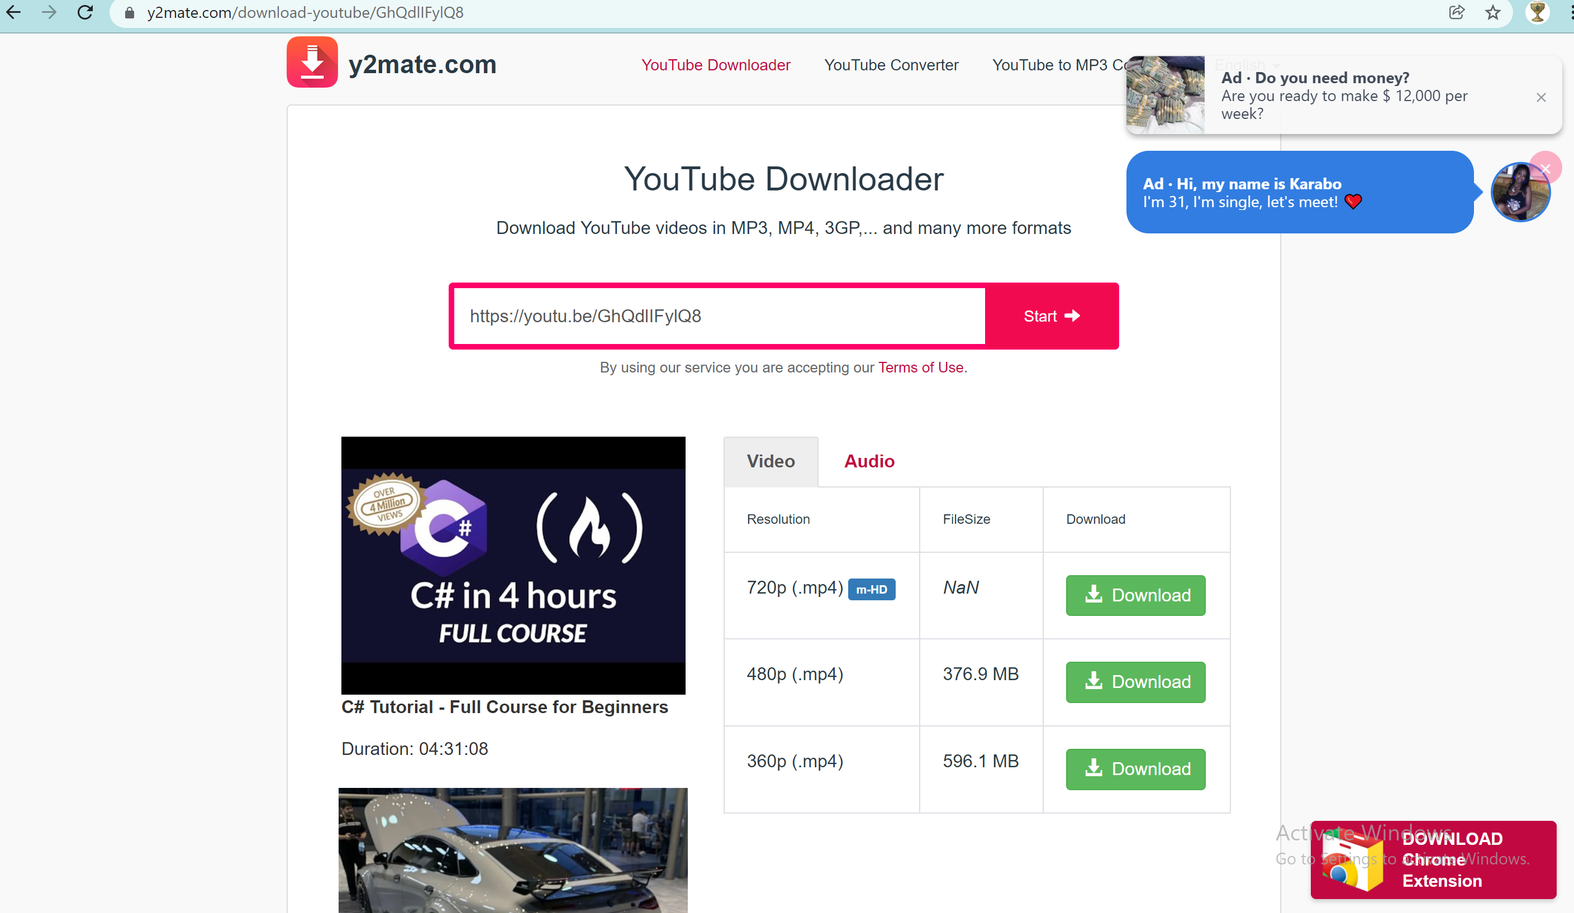
Select your
Download format …
And click download

